Slide 1

Network Devices/Hardware
Computer AIP

Slide 2
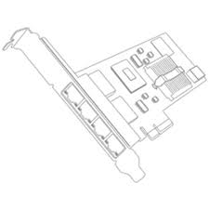

ETHERNET
Ethernet is a way of connecting computers together in a local area network or LAN. It has been the most widely used method of linking computers together in LANs since the 1990s. The basic idea of its design is that multiple computers have access to it and can send data at any time. Ethernet can go at different speeds.

Slide 3
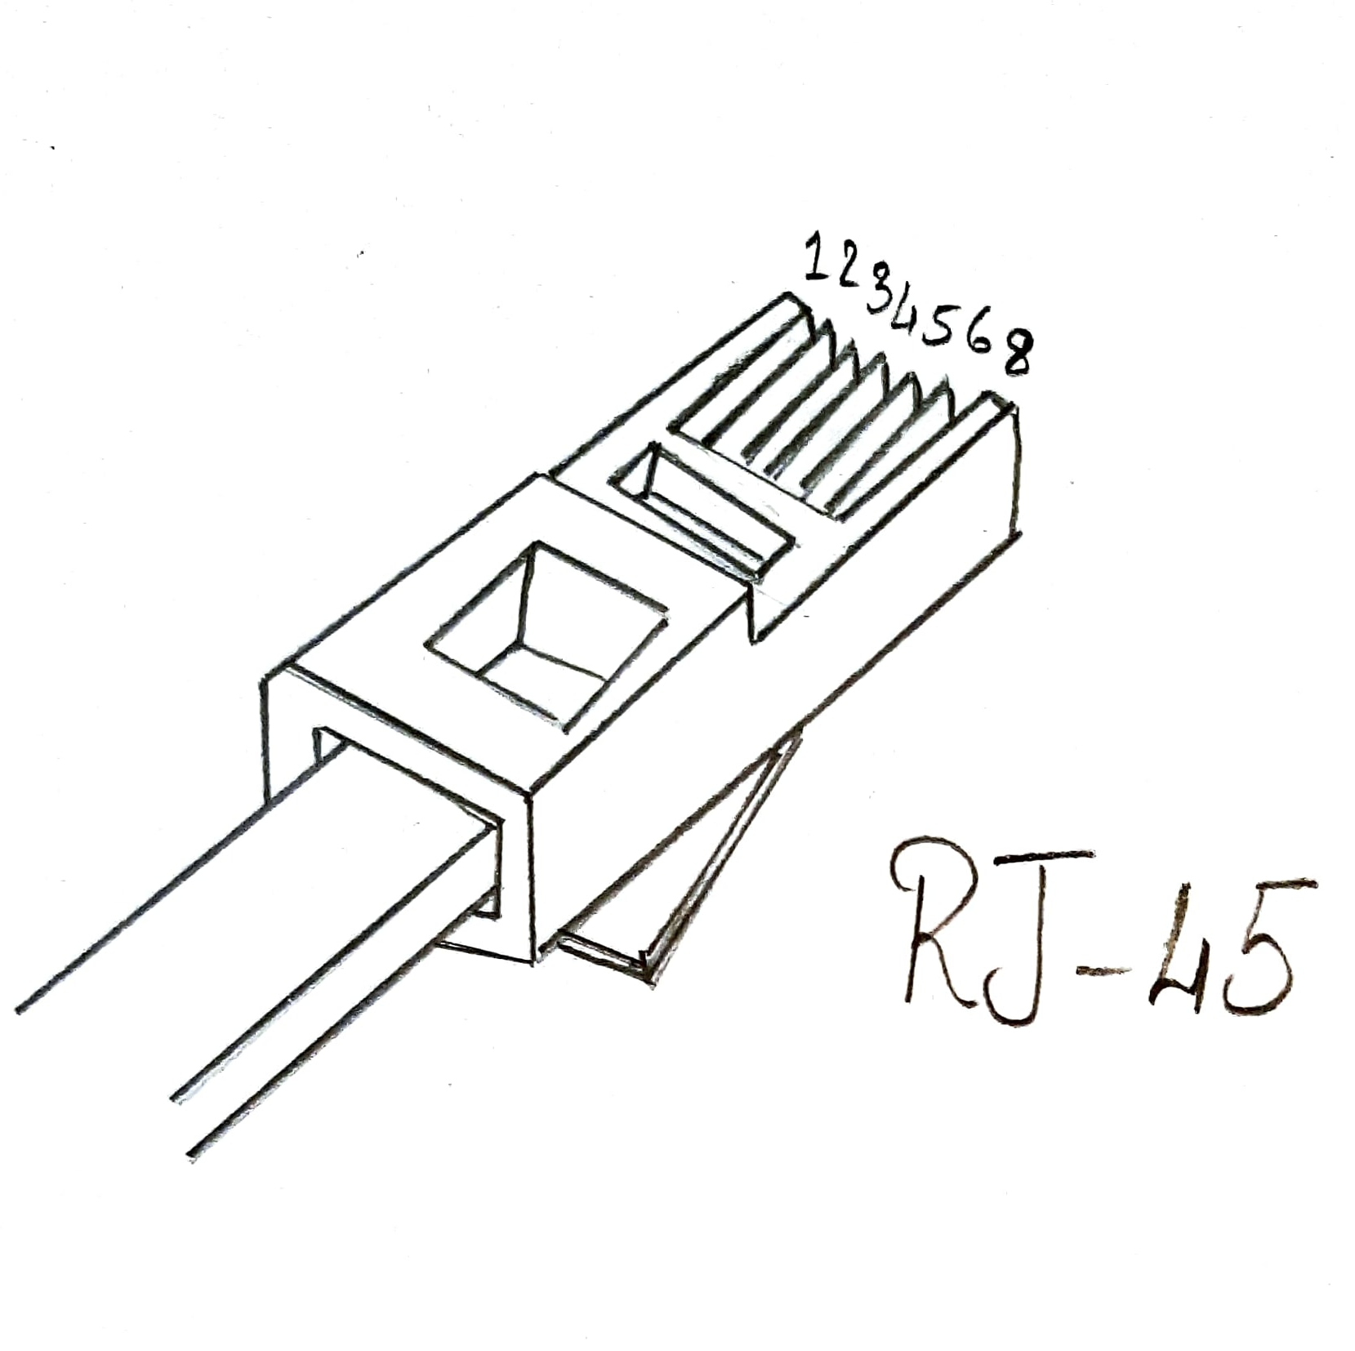
RJ - 45
RJ – 45 is the short form of Registered Jack – 45.
It is an eight wire connector used to connect nodes to the local area network.
It looks similar to the standard telephone connector (RJ – 11) except it is wider and has eight wires instead of four.

Slide 4
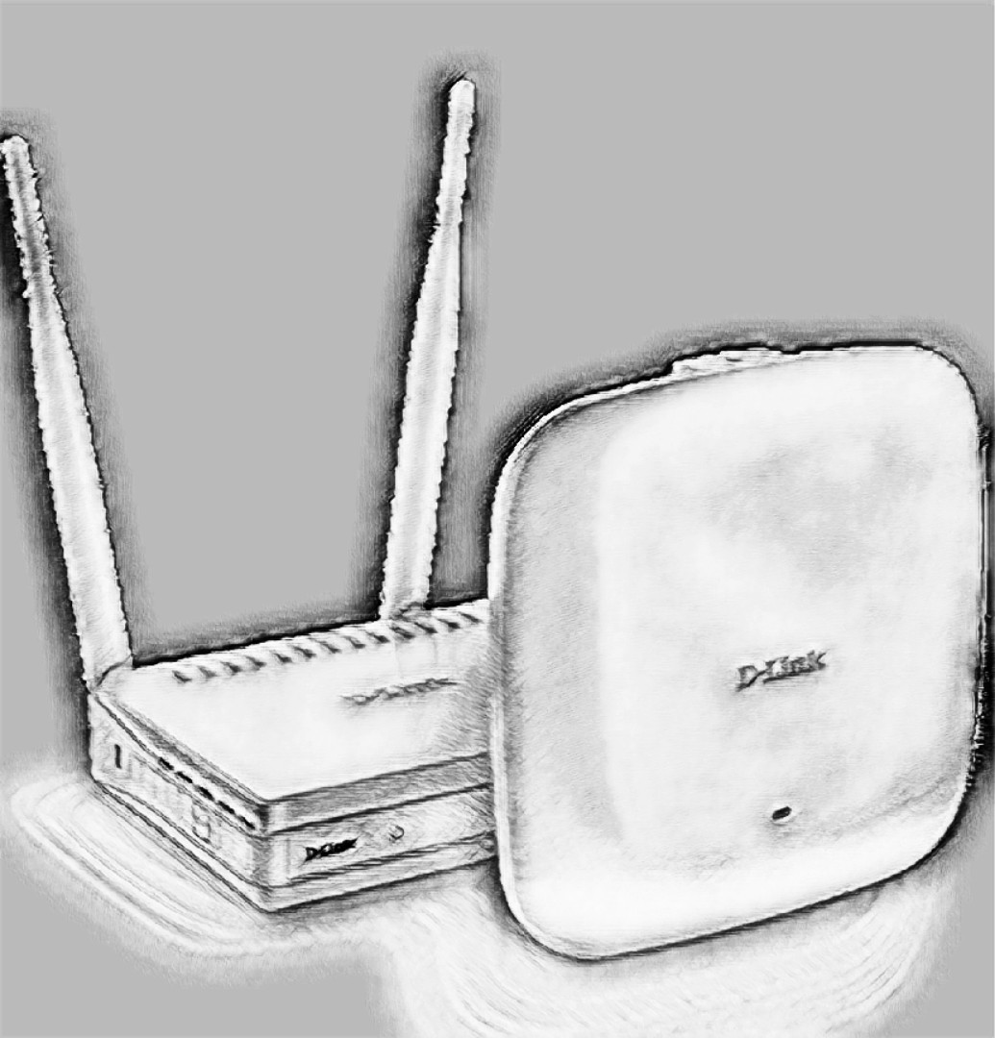
ACCESS POINT
An access point(AP), also called a wireless access point(WAP), is a hardware device that establishes connection(s) of computing devices on wireless LAN with a fixed wire network.
The AP is connected to a fixed wire network and it then broadcasts wireless signals that devices having Wi-Fi cards can detect and connect to the AP to use the network as needed.
Advantages of APs: easier installation, bigger network coverage, stable signals, easier maintenance, and ease of work.
Wireless routers can function as access points.

Slide 5
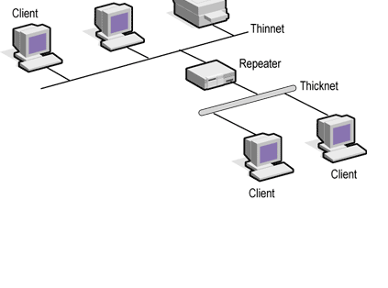
REPEATER
A network device is used to regenerate or replicate the signal.
Repeaters are used in transmission systems to regenerate analog or digital signals distorted by transmission loss

Slide 6
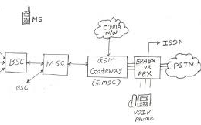
Gateway
A gateway is a node (router) in a computer network, a key stopping point for data on its way to or from other networks. Thanks to gateways, we are able to communicate and send data back and forth. The Internet wouldn't be any use to us without gateways (as well as a lot of other hardware and software).

Slide 7
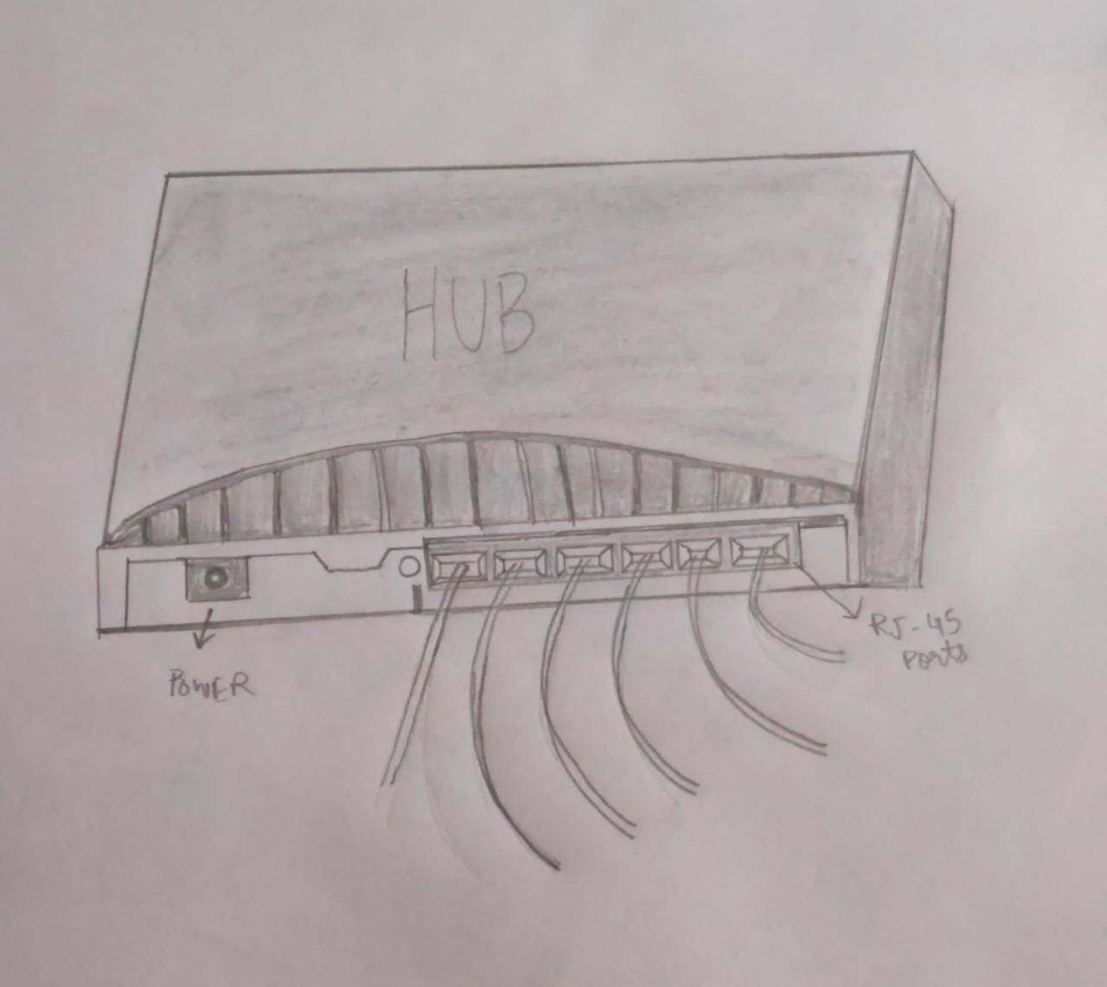
HUB
A hub is a physical layer networking device which is used to connect multiple devices in a network. They are generally used to connect computers in a LAN.
A hub has many ports in it. A computer which intends to be connected to the network is plugged in to one of these ports. When a data frame arrives at a port, it is broadcast to every other port, without considering whether it is destined for a particular destination or not.
There are two types of hubs;
Passive hub:-the signal passes unchanged
Active hub:-Enhances the signal between the workstations.

Slide 8

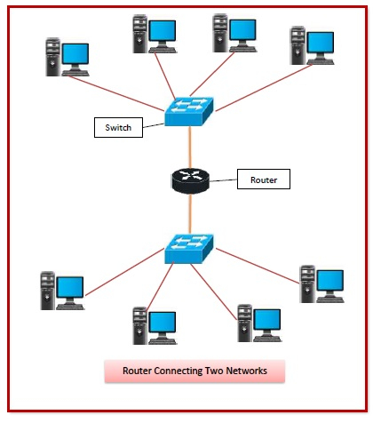
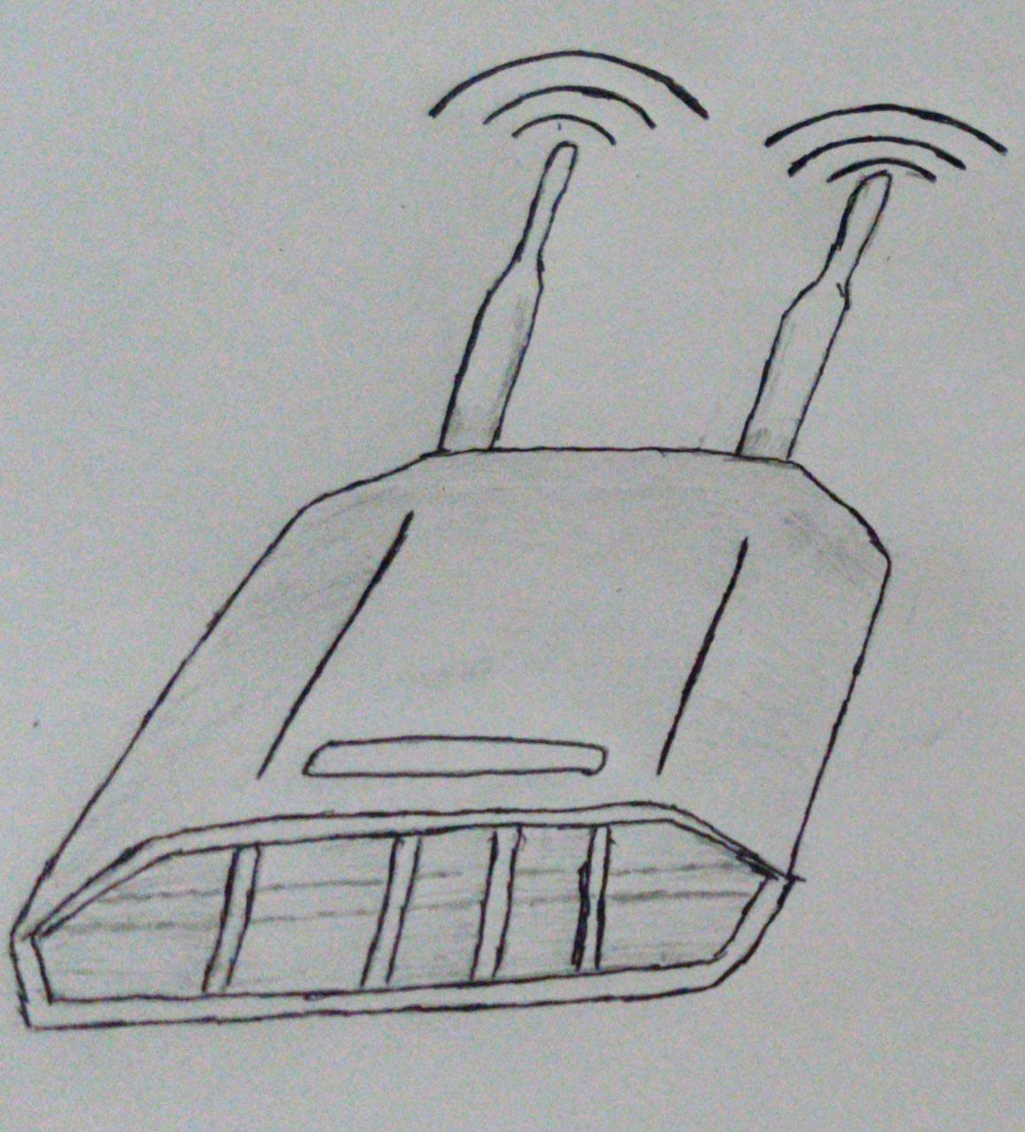
ROUTER
Router is a networking device that forwards data packets between computer networks. Routers perform the traffic directing functions on the Internet. ... Then, using information in its routing table or routing policy, it directs the packet to the next network on its journey.
Features of Routers:-
A router is a layer 3 or network layer device.
It connects different networks together and sends data packets from one network to another.
A router can be used both in LANs (Local Area Networks) and WANs (Wide Area Networks).
It transfers data in the form of IP packets. In order to transmit data, it uses IP address mentioned in the destination field of the IP packet.

Slide 9
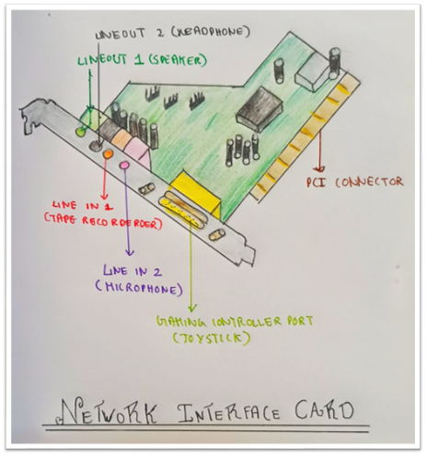
Network interface card (NIC)
Network interface card is a device that is attached to each of the workstations and the server, and helps the workstation establish the all-important connection with the network. Each NIC has a unique number identifying it, which is known as Node Address.
NIC is also called Terminal Access point (TAP) and Network Interface Unit (NIU).
NIC manufactures assigns a unique physical address to each NIC card. This physical address is called MAC address.

Slide 10
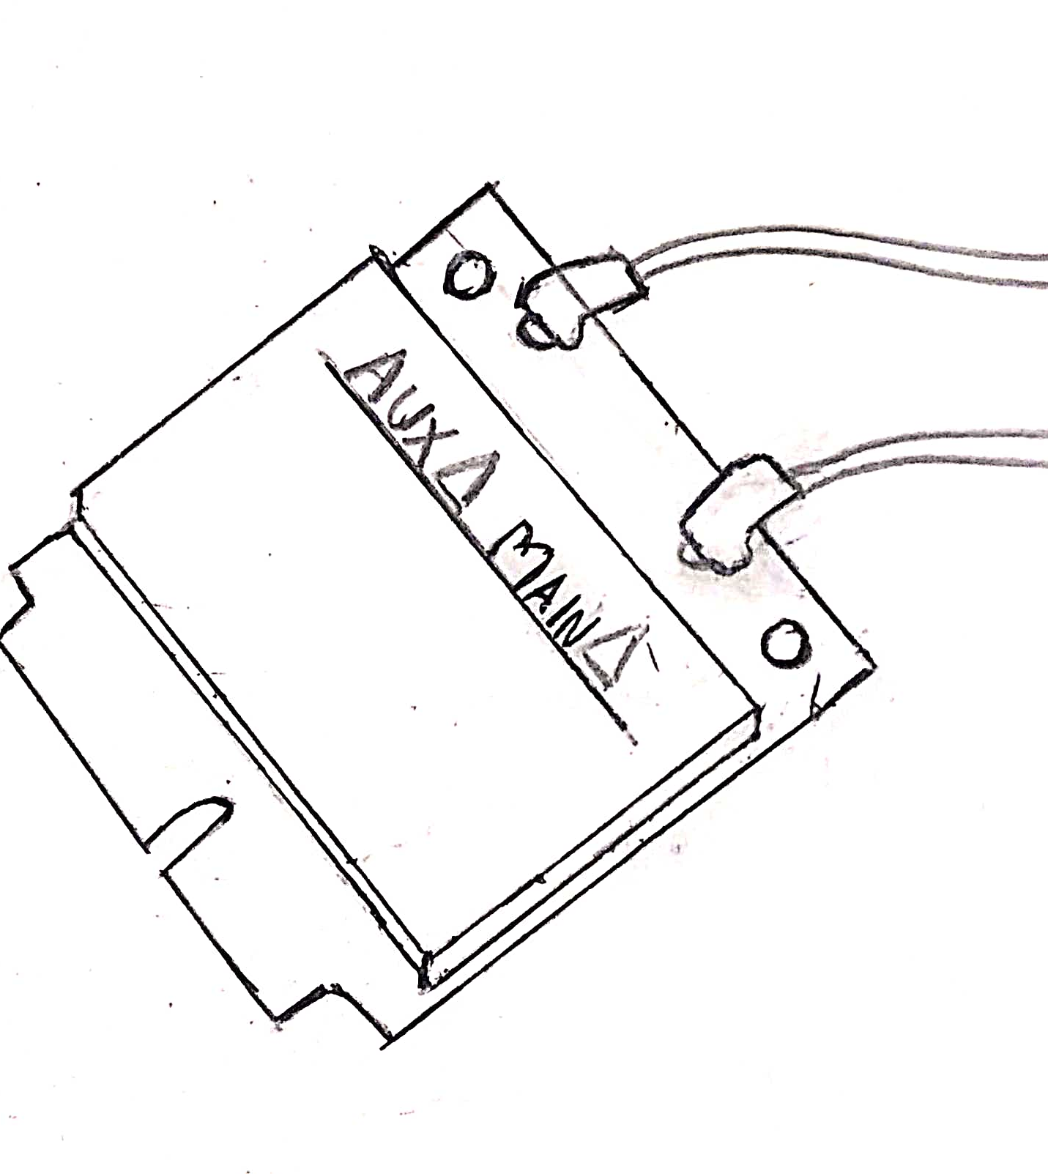
Wi-Fi Card
Wireless Internet cards, also known as Local Area Network, or LAN, cards, are one of the many types of adapter cards that add capabilities to your computer. Other adapter cards can enable teleconferencing, improve sound systems or download photos from a digital camera
Wireless Internet cards come in several forms. Different cards exist for laptops, desktops and PDAs. Many computers come with one preinstalled, but they can also be purchased relatively inexpensively and self-installed or simply inserted into a slot on the side of the computer

Slide 11
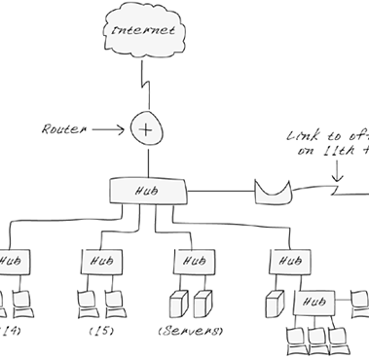
Bridges
A network bridge is a computer networking device that creates a single aggregate network from multiple communication networks or network segments.
This function is called network bridging. Bridging is distinct from routing. Routing allows multiple networks to communicate independently and yet remain separate, whereas bridging connects two separate networks as if they were a single network.in the OSI model, bridging is performed in the data link layer (layer 2).
If one or more segments of the bridged network are wireless, the device is known as a wireless bridge.

Slide 12


Done By :-
Vineet
Skhanda
Abhinav
Shrisha
Siddarth
Vismai
Vaibhav MK
Shreyas R
Tejas
Yatindra

